Slide 1
Bank Loan Case Study
Mohak Shah

Slide 2
Tech Stack Used

Slide 3





Content Title
Matplotlib and Seaborn for Data Visulizations
Python : to do Exploratory Data Analysis
Spreadsheets for Data Manipulation
Findings are done on Bank Loan Data
Trainity

Slide 4
Introduction

Slide 5
📌 What is Exploratory Data Analysis (EDA)?
EDA helps us understand data before applying machine learning models.
It involves handling missing values, visualizing distributions, and identifying key patterns.
📌 Datasets Used:
  Application_data.csv
  Previous_application.csv
Application Data → Current loan applications.
Previous Application Data → Past loan applications of the same customers.

Slide 6
Dataset Overview
📌 Application Data:
📌 Previous Application Data:
Number of rows: 50,000
Number of columns: 122
Key Features:
  SK_ID_CURR
  AMT_INCOME_TOTAL
  AMT_CREDIT
  NAME_CONTRACT_TYPE
Number of rows: 50,000
Number of columns: 37
Key Features:
  SK_ID_PREV
  SK_ID_CURR
  NAME_CONTRACT_STATUS
  AMT_CREDIT

Slide 7
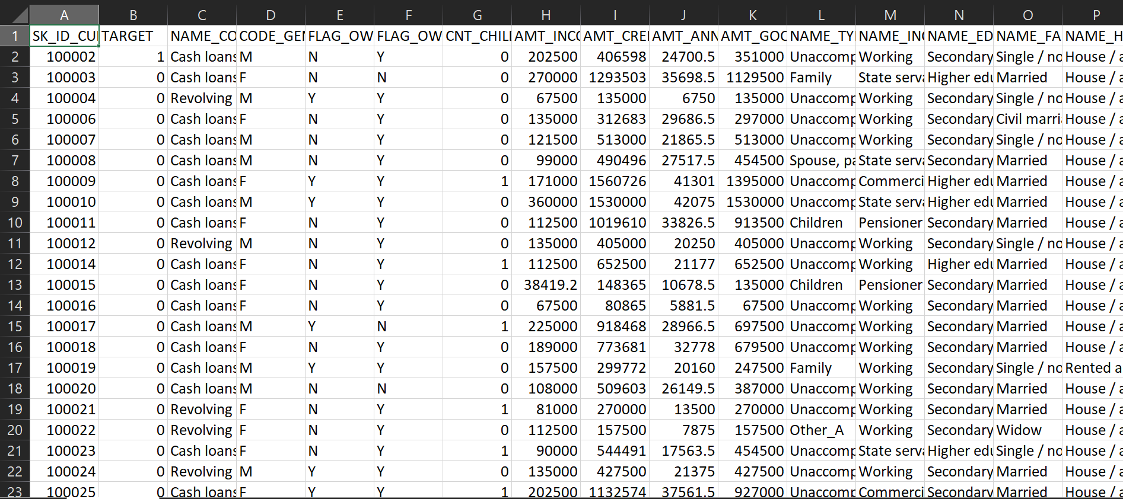
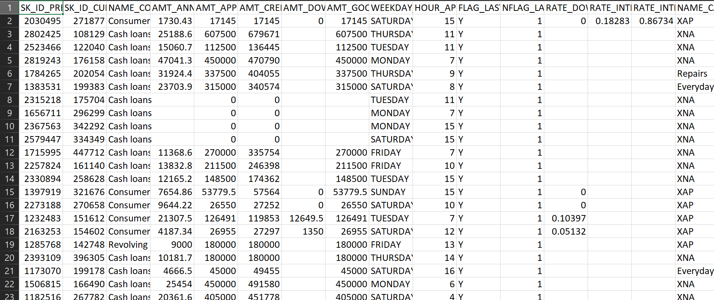
Glimpse of Dataset
Previous Application Data
Application Data

Slide 8
Task Overview
1. Missing Value Analysis
3. Data Distribution and Outliers
2. Handling Missing values
4. Correlation Data

Slide 9
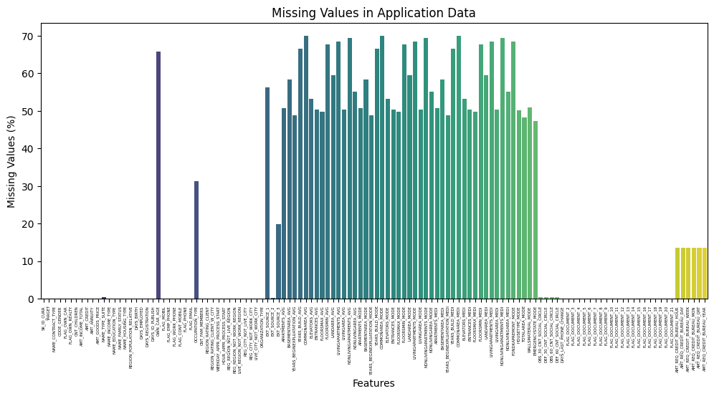
Missing Value Analysis
📌 Missing Values in Application Data:
Highest missing:
  OWN_CAR_AGE (65.9%)
  OCCUPATION_TYPE (31.3%)
Other affected features:
  AMT_ANNUITY
  AMT_GOODS_PRICE
📌 Missing Values in Previous Application Data:
Highest missing:
  RATE_INTEREST_PRIMARY(99.67%)
  AMT_DOWN_PAYMENT (50.4%)
Other affected features:
  NAME_TYPE_SUITE,
  CNT_PAYMENT

Slide 10
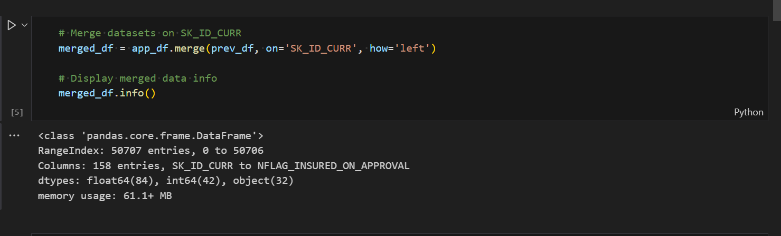
Handling Missing Values
📌 Approach:
Numerical Features:
  Filled with median values
Categorical Features:
  Filled with mode ('Unknown')
📌 Example Code:
app_df.fillna(app_df.median(), inplace=True) prev_df.fillna(prev_df.median(), inplace=True)

Slide 11
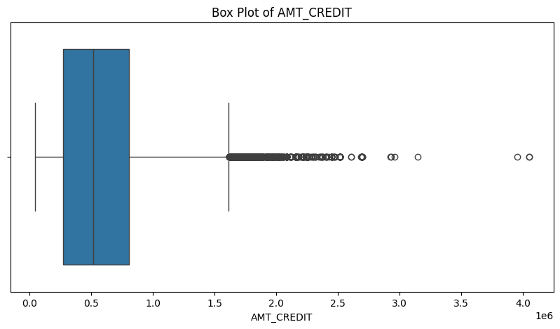
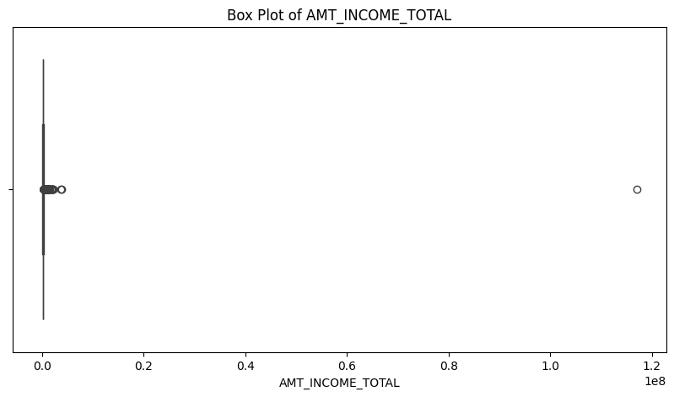
Data Distribution and Outliers
📌 Visualizing Key Features:
  AMT_INCOME_TOTAL (Income distribution)
  AMT_CREDIT (Loan amount distribution)
📌 Outlier Detection:
  Box plots highlight extreme values.
  Some applicants have very high incomes, affecting the data distribution.

Slide 12
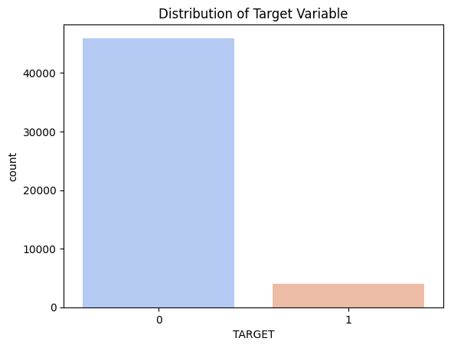
Correlation Analysis
📌 Key Findings:
AMT_CREDIT is highly correlated with AMT_ANNUITY and AMT_GOODS_PRICE.
DAYS_BIRTH (age) has a moderate negative correlation with loan approval.
📌 Heatmap Interpretation:
  Darker colors show strong relationships.
  Helps identify the most relevant features for modeling.

Slide 13
Insight Summary
📌 Major Findings:
✅ Large missing values in OWN_CAR_AGE and RATE_INTEREST_PRIMARY.
✅ Customers with lower incomes tend to apply for smaller loan amounts.
✅ Loan amount is strongly related to annuity and goods price.
✅ High-income applicants tend to have fewer rejections.

Slide 14
Thank You

